Slide 1
W1_D3 - Linear Algebra
Sivasankar Arul

Slide 2
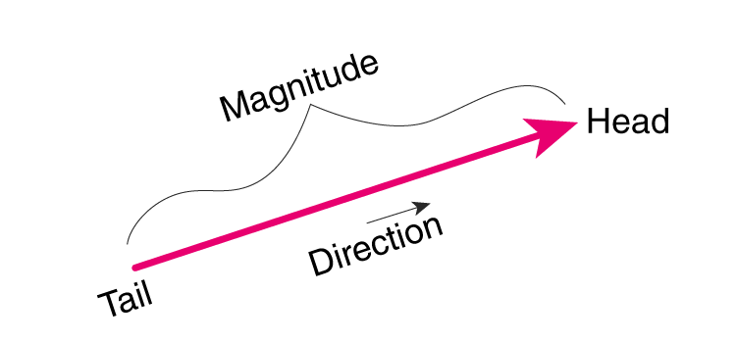
Vectors - understanding it
2. Examples in Everyday Life
Vectors show up in many common situations: - Wind: If someone says the wind is blowing 20 km/h to the east, that’s a vector: it has both speed (20 km/h) and direction (east). - Walking: If you walk 5 meters north, that’s also a vector: the distance (5 meters) and the direction (north) together form the vector.
1. A Vector is Like a Directed Arrow
Imagine you are standing in a park, and I ask you to walk in a specific direction for a certain distance: Direction: I might point towards a tree. Distance: I might tell you to walk 10 steps. This combination of direction and distance is what a vector represents. You can think of it as an arrow: - The arrow points in the direction you should walk. - The length of the arrow represents how far you should walk. So, a vector has two important things: - Magnitude (the length of the arrow) – how far. - Direction (which way the arrow is pointing) – where to go.

Slide 3
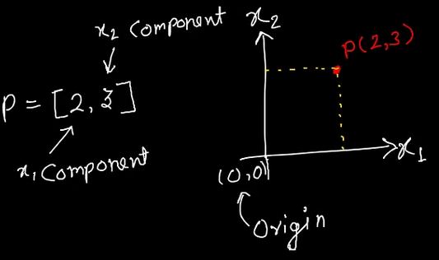
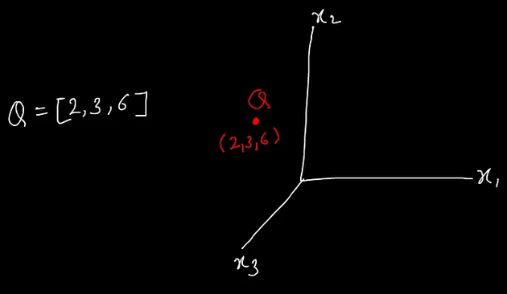
Vectors - plotting it
2 Dimensional space
3 Dimensional space

Slide 4

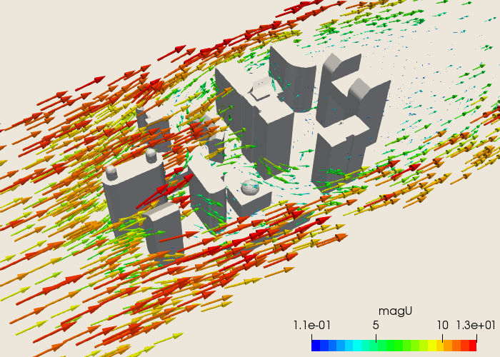
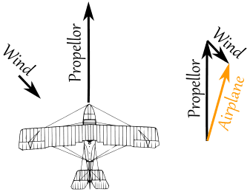
Vectors - understanding it
Examples in Everyday Life

Slide 5
Vectors - understanding it
Examples 1
The color says the amplitude( strength of wind)
Red indicates strong wind
Green indicates slow wind

Slide 6
Vectors - understanding it
Examples 2
The strength can also be seen from the length of the vector
Propellor vector is longer - is stronger than wind vector

Slide 7
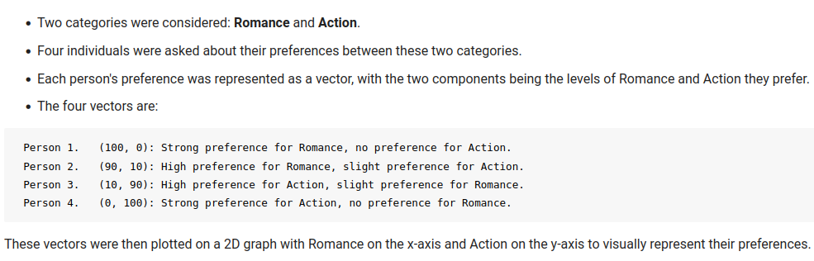
Vectors - understanding it - 01_vector_demo.ipynb
Examples 3
Action
Romance

Slide 8
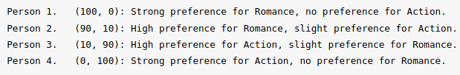
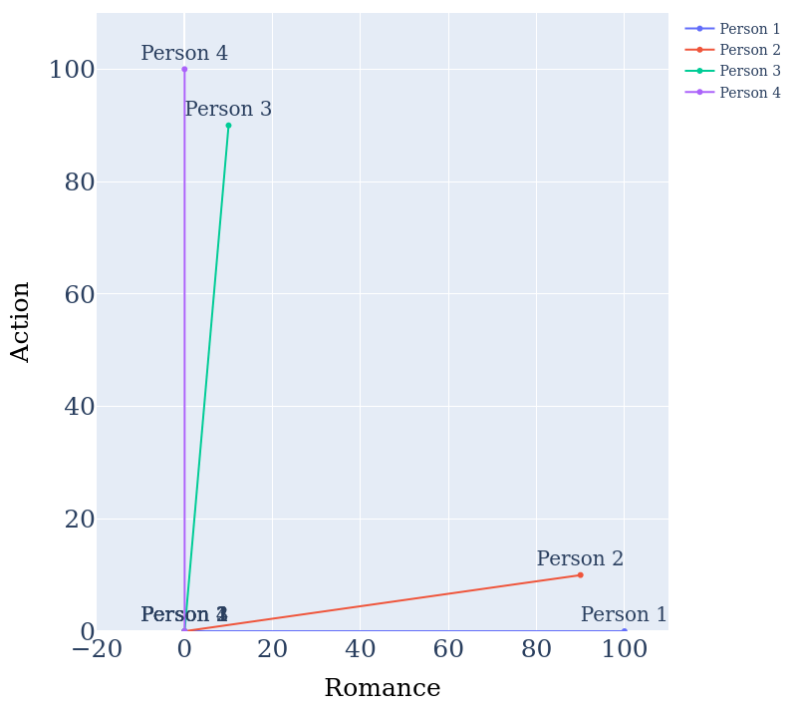
Vectors - understanding it
Examples 3
The preference of a person for a genre can be easily understood from the score.
The score also reveals which among 4 have similar preference for a genre.

Slide 9
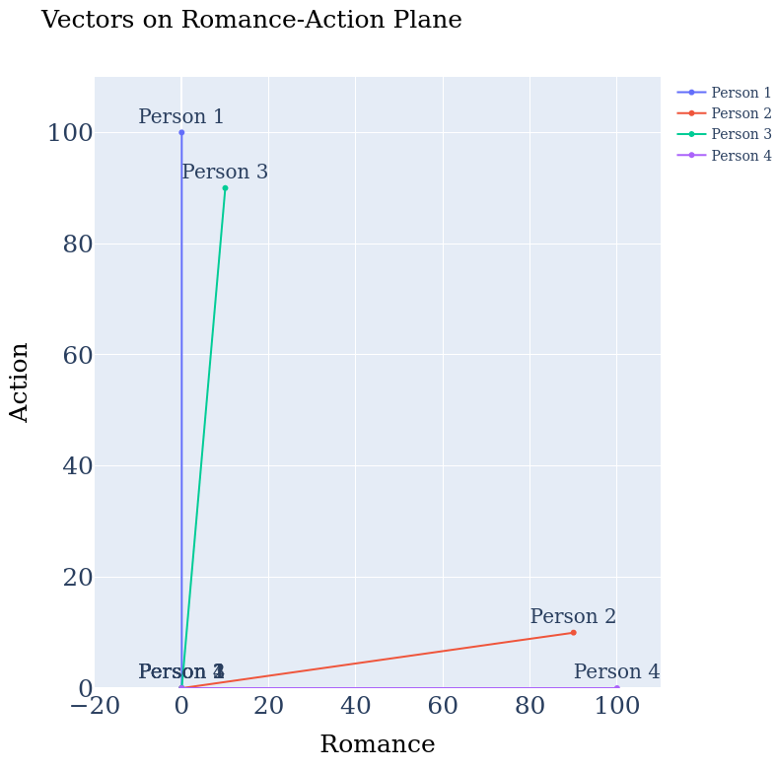
Vectors - understanding it
Examples 3
It can also be found from the angle between the two vectors.
If the angle between two vectors is small, then it means they are closely related.
1 and 3
2 and 4
If the angle between two vectors is 90 degree, it means there is not relation.
1 and 4
If the angle is 180 degree, it means they are opposite relation.

Slide 10
Vector - operations
Introduction to Vectors for Data Science by Vishal Kumar Medium pdf
https://vish0709.medium.com/introduction-to-vectors-for-data-science-part-1-e9a3cef879c

Slide 11
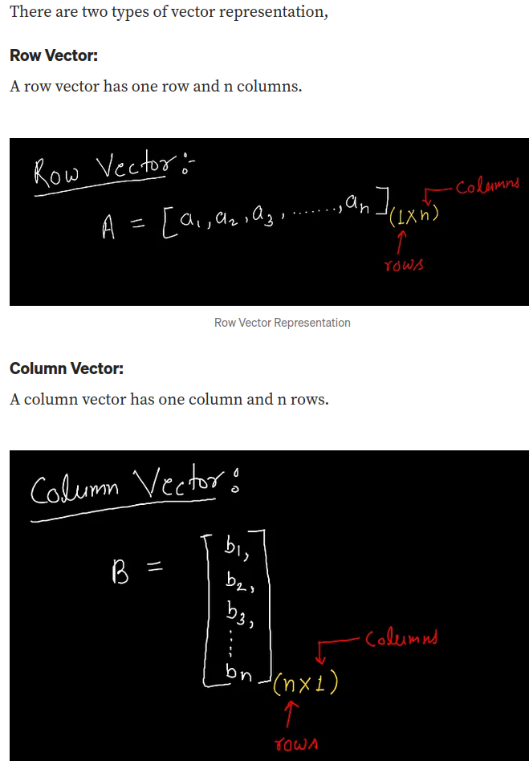
Vectors

Slide 12
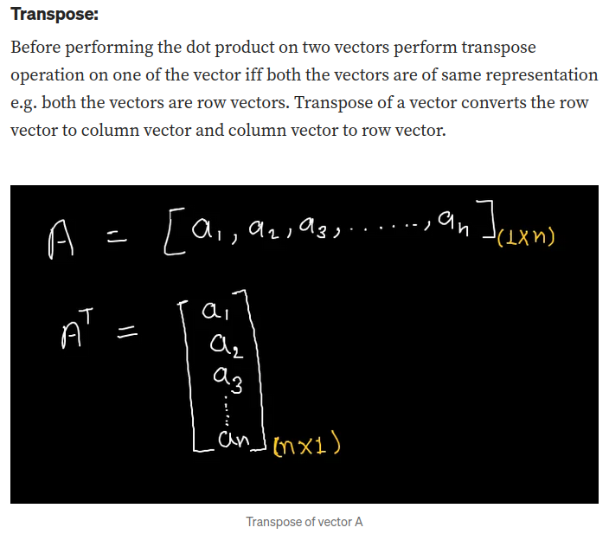
Vectors

Slide 13
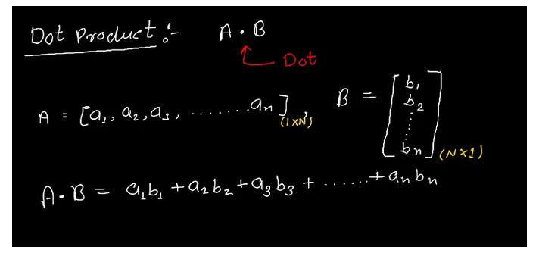
Vectors - Dot product

Slide 14
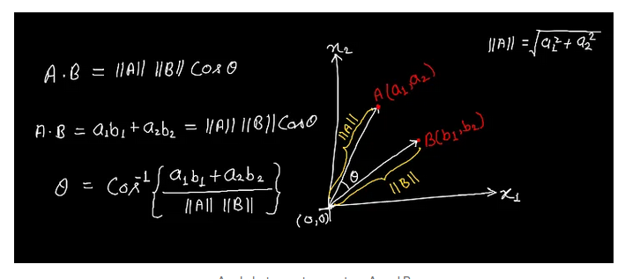
Vectors - Dot product -Geometric interpretation

Slide 15
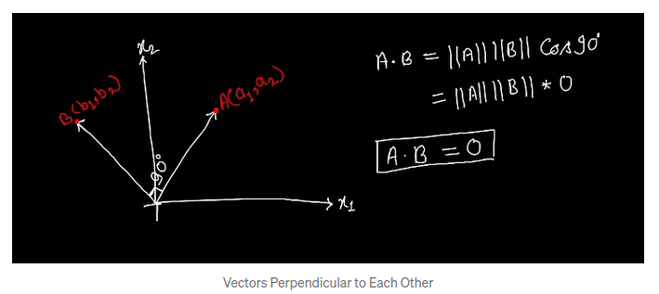
Vectors - Dot product -Geometric interpretation

Slide 16
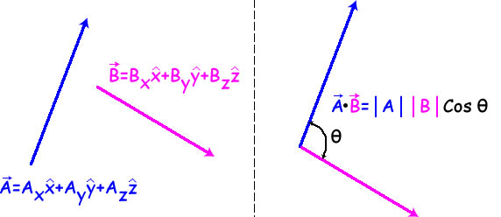
Vectors - Dot product
Geometric meaning:
The angle in the dot product reveal how the two vectors are related

Slide 17
Vectors
02_vector_application_nearness.ipynb

Slide 18
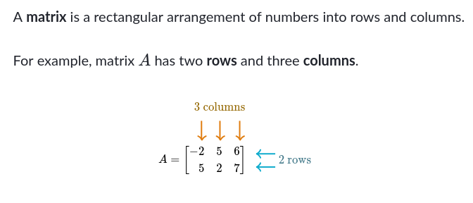
Matrix

Slide 19

Matrix - understanding it
1. Start with the Basics
A matrix is just a way to organize numbers in a rectangular grid or table.
It’s like a spreadsheet where numbers are arranged in rows (horizontal) and columns (vertical).
2. Introduce Dimensions
The size of a matrix is called its dimensions.
For example, a 2x3 matrix has 2 rows and 3 columns.
It looks like this:

Slide 20

Matrix - understanding it
3. Real-life Analogy
Think of a matrix like a list of things organized neatly.
If you were tracking students' scores in different subjects, a matrix could show the data.
Rows represent each student and columns represent subjects like Math, Science, etc.
Math
science
Student 1
Student 2
Student 3

Slide 21
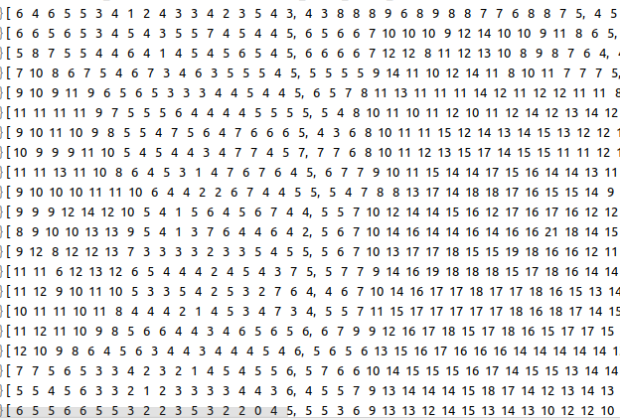

Matrix - Image
0
255
40
170

Slide 22

Matrix - subtraction
4. Example
If you have 3 students and you record their scores in 2 subjects, a matrix could look like:
TEST 1
TEST 2
Math
science
Math
science
Student 1
Student 1
Student 2
Student 2
Student 3
Student 3

Slide 23

Matrix - subtraction
4. Example
If you have 3 students and you record their scores in 2 subjects, a matrix could look like:
TEST 1
TEST 2
Math
science
Math
science
Student 1
Student 1
Student 2
Student 2
Student 3
Student 3

Slide 24
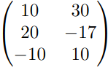
Matrix - subtraction
4. Example
If you have 3 students and you record their scores in 2 subjects, a matrix could look like:
TEST 1
TEST 2
Math
science
Math
science
Student 1
Student 1
Student 2
Student 2
Student 3
Student 3

Slide 25


Matrix Vector Multiplication
Let's say we have materials wood, metal, and fabric.
We are making a chair, table, desk.
The chair needs 5 wood, 2 metal and 1 fabric
The table needs 8 wood, 4 metal and 2 fabric
The desk needs 10 wood, 5 metal and 3 fabric.
Now let’s write it as matrix.
Let's say these are costs:
wood = $10, metal = $15, fabric = $8.
Let’s write this as vector
wood
metal
fabric
wood
chair
metal
table
fabric
desk

Slide 26
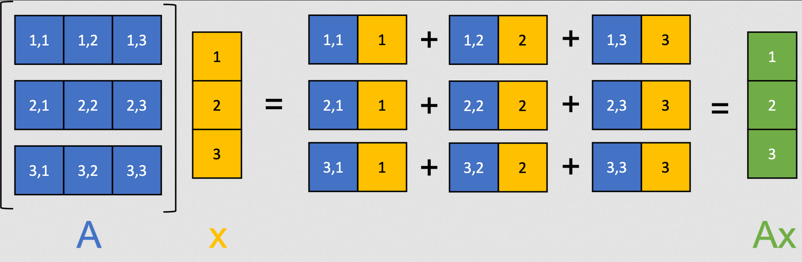
Matrix Vector Multiplication definition

Slide 27
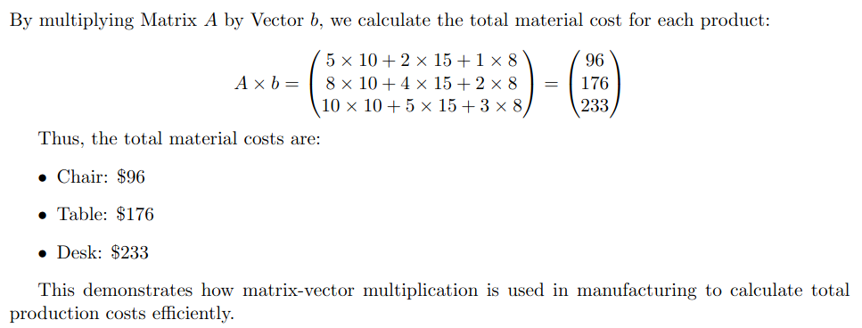
Matrix Vector Multiplication
wood
metal
fabric
wood
chair
metal
table
fabric
desk

Slide 28
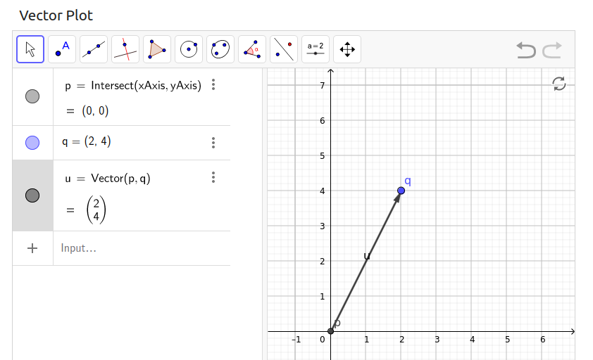

Matrix Vector multiplication - graphical
x
vector

Slide 29
Matrix Vector multiplication - graphical
A
[ X X
X X ]
matrix

Slide 30
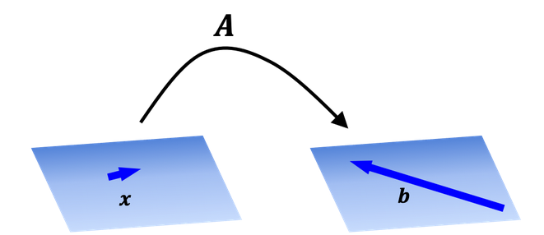
Matrix Vector multiplication - graphical
A x = b
matrix
vector
vector

Slide 31
Matrix Vector multiplication
03_matrix_vector_multiplication_illustration.ipynb

Slide 32
Projection of vector on matrix
03c_vector_matrix_projection.ipynb

Slide 33
Eigen vectors
04_eigenvector_demo.ipynb

Slide 34
Eigen value
An eigenvalue is the amount by which the eigenvector is stretched or compressed.

Slide 35
Eigen vectors
https://wiki.pathmind.com/eigenvector

Slide 36
Eigen vectors
Eigenvectors help us:
Understand the core structure or pattern in large datasets (like in facial recognition or machine learning).
Simplify complex transformations into manageable parts (e.g., reducing a 10-dimensional dataset to a 2D plot without losing significant information).
Analyze and predict behavior in complex systems (e.g., in finance for stock trend predictions).

Slide 37
DETOUR - covariance
Covariance measures how much two variables change together.
A matrix showing variances on the diagonal and covariances off the diagonal.
• Positive covariance: Variables increase/decrease together.
• Negative covariance: One variable increases as the other decreases.
Dataset with values for
X = [1, 3, 5] and
Y = [5, 4, 8].
Observation | X | Y
1 1 5
2 3 4
3 5 8

Slide 38
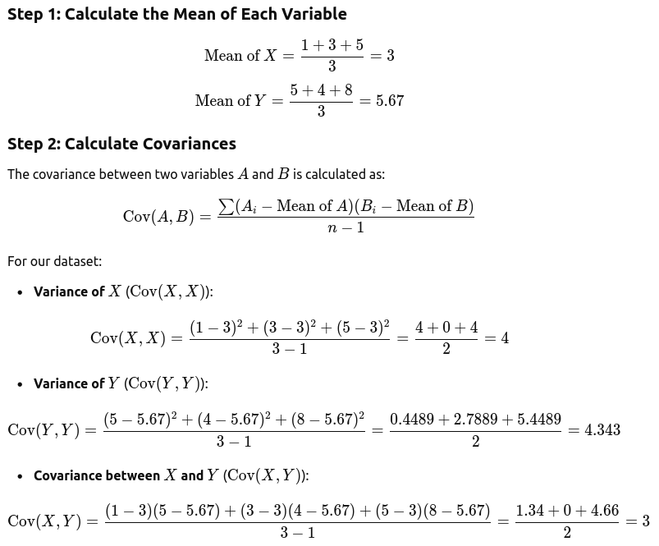
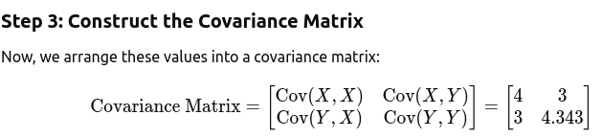
DETOUR - covariance
Dataset with values for
X = [1, 3, 5] and
Y = [5, 4, 8].
Observation | X | Y
1 1 5
2 3 4
3 5 8

Slide 39

DETOUR - covariance
Interpretation
The diagonal elements (4 and 4.343) represent the variances of X and Y, indicating how much each variable varies by itself.
The off-diagonal elements (3) says how X and Y changes in relation to each other: represent the covariance between X and Y,
Value > 0 mean X and Y are positively correlated
Value < 0 mean they are negatively correlated
Value = 0 mean they are not correlated
shows that they have some positive correlation, but the values are different from the variances.
This matrix provides a more realistic representation of a dataset where variables have differing degrees of variability and covariances.
Dataset with values for
X = [1, 3, 5] and
Y = [5, 4, 8].
Observation | X | Y
1 1 5
2 3 4
3 5 8

Slide 40
Covariance matrix
https://www.geeksforgeeks.org/covariance-matrix/

Slide 41
DETOUR - covariance - eigen vectors
Dataset with values for
X = [1, 3, 5] and
Y = [5, 4, 8].
Observation | X | Y
1 1 5
2 3 4
3 5 8
The eigenvalues and eigenvectors of the covariance matrix provide insight into the principal directions of variation in the data. Here’s how:
Eigenvectors: Each eigenvector represents a direction in the data’s space. These directions are the axes along which the data varies the most.
Eigenvalues: Each eigenvalue represents the magnitude of variance in the direction of its corresponding eigenvector. Larger eigenvalues mean that more variance (more "spread") exists along that eigenvector.

Slide 42
Covariance - eigen vector - principal axes
04b_eigenvec_anomaly.ipynb

Slide 43
Transformations in Data Science
Introduction
Purpose: we’re diving into why data transformations are central to data science, especially when dealing with complex datasets.
Key Idea: Transformations allow us to reveal patterns, simplify data structures, and make data more interpretable or usable for algorithms.
Application Examples: When you scale a dataset, normalize features, or reduce dimensions, you’re performing transformations. This process helps data align with analysis goals.
Why Transformations are Essential in Data Science
Reveal Patterns and Trends
Complex Data: Most real-world data is messy or complex, and transformation is the first step to uncovering meaningful patterns.
Example: Rotating a 3D shape reveals a hidden side. Similarly, transforming data can expose correlations or dependencies between variables that were not visible initially.
Enable Preprocessing for Algorithms
Preparing Data: Many algorithms expect data in a specific format or scale. For example, normalization ensures all features are weighted equally, which is critical in machine learning.
Simplify Data for Analysis
Dimensionality Reduction: Techniques like Principal Component Analysis (PCA) use transformations to condense data into lower dimensions, aiding both visualization and computational efficiency.

Slide 44
Transformations in Data Science
Linear Transformations
Defining Linear Transformations
A linear transformation takes a vector and transforms it to another vector, preserving proportions and linear structure.
Example: Imagine stretching, rotating, or reflecting vectors. This is the essence of linear transformations—changing appearance without breaking linearity.
Why "Linear"?
The name "linear" comes from two key properties:
Proportional Scaling: Doubling a vector’s length doubles the length of its transformed version.
Straight-Line Preservation: Linear transformations keep lines straight, although they may stretch, shrink, or rotate them.
Applications in Data Analysis
New Perspectives: By transforming data, we can reveal patterns not visible in the original format, similar to rotating a 3D object for a better view.
Dimensionality Reduction: Techniques like PCA rely on linear transformations to reduce data dimensions, simplifying analysis.
Normalization: Scaling data before inputting it into algorithms ensures each feature has equal importance. This is a linear transformation that’s especially relevant in machine learning, where algorithms like gradient descent rely on balanced feature scaling.

Slide 45
Transformations in Data Science
Non Linear Transformations
Importance of Non-Linear Transformations
Some patterns in data are not apparent when using linear transformations alone. Non-linear transformations help uncover complex, non-linear relationships.
Example: If the relationship between two features is exponential, applying a non-linear transformation (e.g., logarithmic or polynomial) can make this relationship linear and easier to analyze.
Real-World Utility
Improved Algorithm Performance: Non-linear transformations can make data more suitable for machine learning models that struggle with complex or skewed data.
Enhanced Interpretability: Transforming data in ways that reveal structure or patterns can clarify relationships that weren’t initially visible.
Example: Suppose we have data points clustered in a circular pattern. Applying a logarithmic transformation can change this circular data into a more linear format, making it easier to fit with linear models.

Slide 46
Transformations in Data Science
Nonlinear_tranformation_log.ipynb

Slide 47
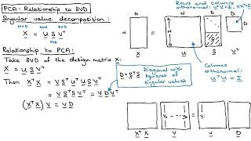
PCA <-> SVD

Slide 48
Matrix Vector multiplication - solving equation
What are equation?
Lets take a equation with two variable x and y:
Eg: 4x + 4y = 6

